Slide 1
Hnefatafl
BetterByte
Carson Tunnell
Dan McClure
John Pokorski
Hayden Cannalte
Devin Dennis

Slide 2
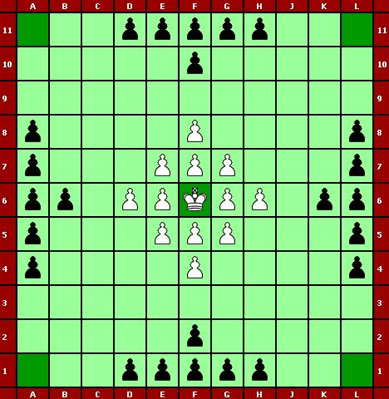
Rules

Slide 3
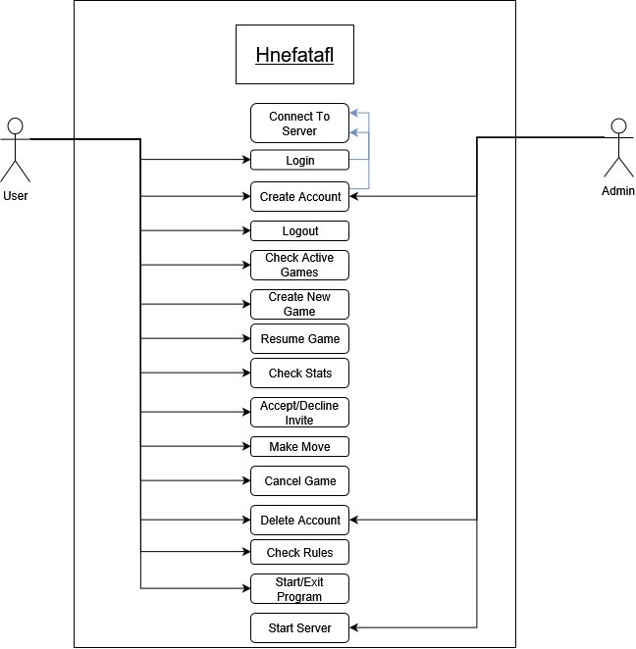
Use Case

Slide 4
Questions?

